Slide 1
EVADC Timing 23 Mar 2021
C_PMC_11F/5.1/27-Feb-19

Slide 2
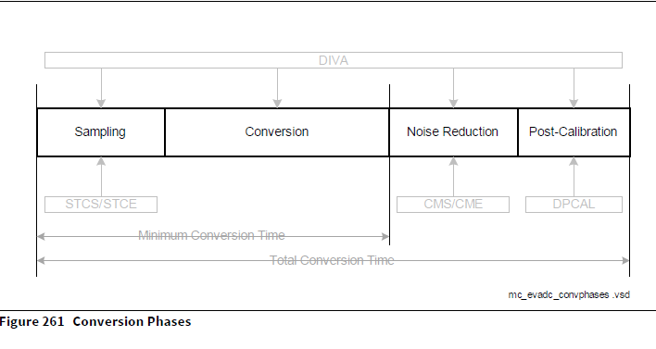
EVADC is used to scan the fault signal and closed loop input signal
Primary converter to scan Closed loop
Secondary converter to scan fault signal
ADC Maximum frequency 20Mhz
Sample time minimum 100ns ( yet to try with realtime hardware)
Result generation time 650ns
Minimum time of conversion without post calibration is 768.75ns (single channel)
According to datasheet for single channel EVADC need 868.75ns for single channel sample + conversion time (minimum conversion time)

Slide 3
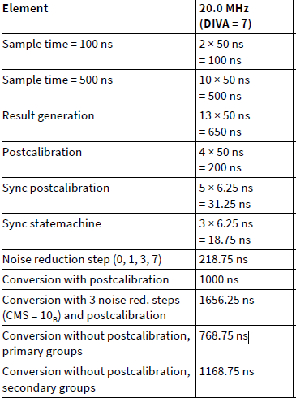
Taken the Minimum Time which mentioned in Datasheet. Testing with MADK board is pending.
(sampling time may increase while testing with Hardware)
Primary and secondary converter perform concurrently
9 - Primary (Closed loop) channel in primary queue
42 – secondary channel in secondary queue
Conversion time for all primary channel is
Total Time = (9 * Sampletime + Conversion Time)
= (9 * 768.18)ns
= 6913.6 ns (6.9uS)
i.E : Sample time + Conversion Time is 768.18ns

Slide 4
Secondary channel Timing = (41 * 1168.75)ns
Concluded :
Primary Interrupt will generate after completion of all 9 channels ( every 6.9us)
Secondary channel interrupt will generate in every (48us)
Adding 9 Leg current sensor in Primary channel will lead extra conversion time which is not possible in 2us. It will also affect the timing of closed loop conversion.
Note : Broken-Wire Detection not included in above conversion

Slide 5
THANK YOU
C_PMC_11F/5.1/27-Feb-19

